Slide 1

Multithreading in Java
CMPT 470 A2b Presentation
Yinsheng Dong
Ruida Xie
Hao Li

Slide 2
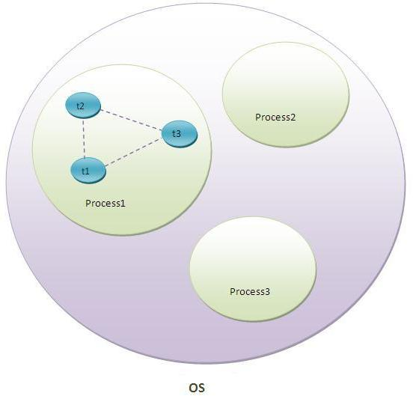
Introduction of Multithreading in Java
A Java feature multiple threads can be executed simultaneously in one process
A thread is the smallest unit of a process
To achieve Multitasking on computers
Multiprocessing (Process-based Multitasking)
Multithreading (Thread-based Multitasking)
Maximum utilization
Notes:
A short introduction of Java Multithreading.
Generally, programmers could achieve multitasking in OS level by 2 ways. Multiprocessing and Multithreading
Multithreading is a Java feature to execute multiple thread simultaneously within a process, and they are not affected by each other. Just like the pic shows
Multiprocessing is same idea, but we execute processes simultaneously.
We use Multithreading in Java because a thread is the smallest unit of a process, so it will maximize utilization in OS

Slide 3
Why We use Multithreading in Java
Programmers can make user tasks run at the same time (e.g. User Interface)
It can improve CPU power (use every core efficiently)
Multithreading in Java approach to reduce response time by diving a big submit task into multiple subtasks (Fork/Join thread pool)
Serve multiple clients at the same time (e.g. Java based server)
Notes:
Why we use Java Multithreading?
Make user tasks run at the same time (e.g.) when user is loading a game, in this time, the thread of game is frozen, it can show the loading process in UI part by using other thread.
Improve CPU power, generally, CPUs in our computers have 2 cores, 4 threads, or 4 cores 8 threads, to make them more efficiently, we use multithreading.
Fork/Join thread pool, it is a Java feature, it is using to divide a big task to multiple subtasks, and these subtasks can also be divided, so it can reduce response time.
Serve multiple clients at same time, such as Glassfish or Tomcat in Java EE

Slide 4
Thread Life Cycle in Java
New State: when a new thread is created.
Runnable State: the thread is ready to run.
Blocked/Waiting State: the thread is still alive, but it is not able to run currently.
E.g. while two thread try to access a protected code at same time.
Timed Waiting State: need to wait a timeout notification.
E.g. when a thread calls a method with the timeout parameter.
Terminated Statement: A thread terminiates or dead.
Exits when the program has fully executed.
Or some unexpected event happened (power cut)
Notes:
In this slide, I will talk about thread life cycle in Java.
New State: when a new thread is created.
Runnable State: the thread is ready to run
B/W State: the thread is still alive, but can not be run currently. E.g. 2 threads try to access a protected code at same time, in this situation, one thread has to wait until the other one finish its work.
Timed Waiting State: A thread waits for other one by a specified waiting time
Terminated Statement: fully executed or some unexcpecetd event happened

Slide 5
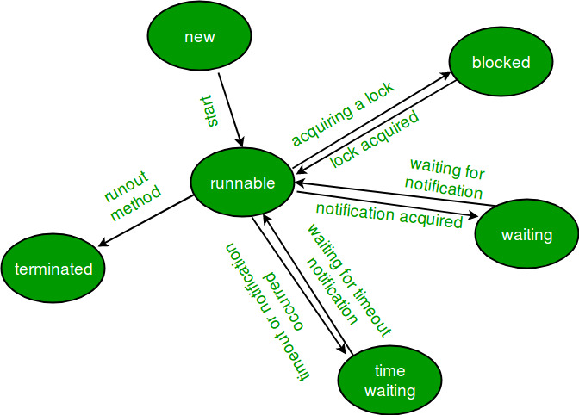
Thread Scheduler in Java
Thread Scheduler in Java (JVM) decides which thread should run.
There is not guarantee that which runnable thread will be run by the thread scheduler.
Usually uses preemptive or time slicing scheduling.
Notes:
We just introduced thread life cycles in Java, but how they are working is controlled by Thread scheduler
It decides which thread should run, but it can not guarantee which specific runnable thread will be run.
E.G. A and B try to access a protected code, A thread came first, B is second, but the code is using by other one right now, so they are both in Block/Waiting State, but thread scheduler can release B first to access the code.

Slide 6
Simple Implementation of Java Multithread
Inherit the Thread class
Implement the Runnable interface
Notes:
In software engineering, implementing the Runnable interface is the most popular way.

Slide 7
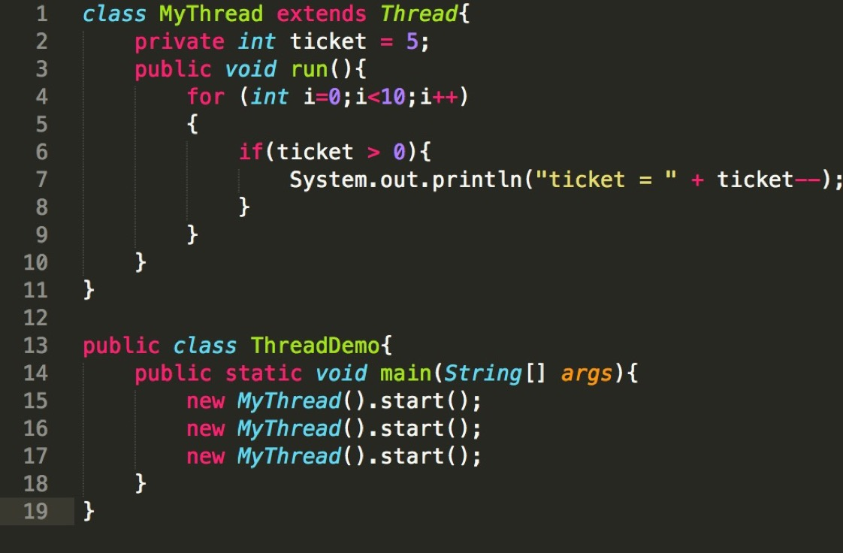
Notes:
In this figure, each thread alone sold five tickets, i.e. each thread completes the task independently.
In this figure, we created 3 Thread objects. Three threads execute the code in each of the three objects;

Slide 8
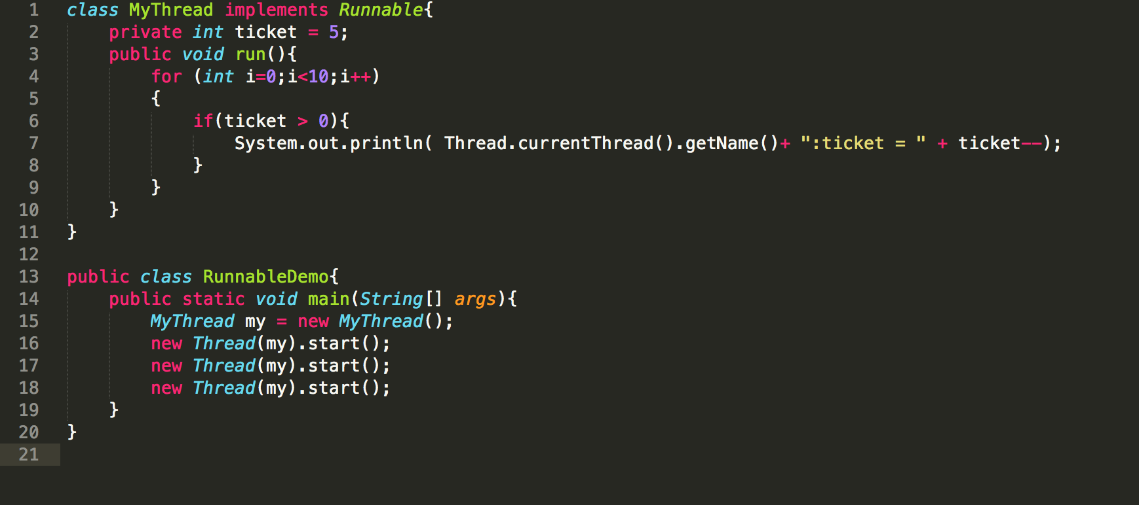
Notes:
in this example, we also created 3 Thread objects, but only one Runnable object, 3 Thread objects is sharing resources in this Runnable object. Therefore, there will be three threads together to complete the ticketing task. If we created 3 Runnable objects, as the parameters were passed into three Thread objects, then three threads will be independent of their respective Runnable object code. In that case, three threads each sell five tickets.

Slide 9
Could be unsafe
The ticket may output -1. This situation is due to a thread determine ticket is 1> 0, and another thread subtract the ticket number by 1=0 . Then the previous thread subtract ticket by 1 , they got -1.
Need synchronization mechanism
Notes:
Synchronization mechanism using synchronized modifier is called mutex mechanism. Each object has a monitor (lock tag), when the thread has this lock tag can access this resource. Otherwise the thread will enter the lock pool. Any object system will create a mutex for it; the lock is assigned to the thread to prevent the interruption of atomic operations. The lock of each object can only be assigned to a thread, so-called mutex.

Slide 10
Disadvantages and Possible Solutions
Difficulty of writing code
Dead Lock
Debugging and Testing

Slide 11
Difficulty of writing code
MultiThreading Java not means several single thread java code adding together, programmers should able to put lots of threads together in same data, object and program
Make Organized Clearly
Use Immutable Object
Warp up all unsafe threads

Slide 12
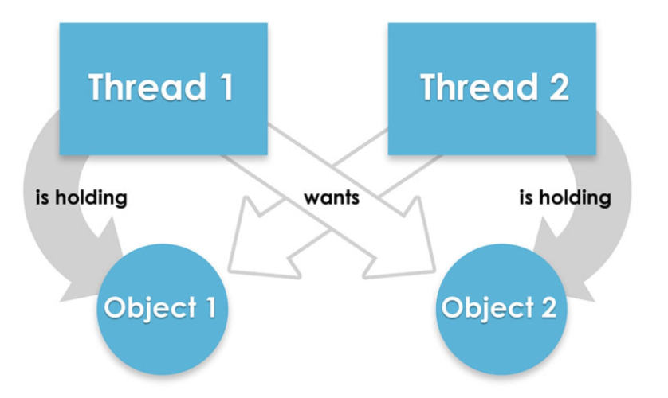
DeadLock
Thread 1 need Object 2 ( holding by Thread 2) to process, but Thread 2 also need Object 1(holding by Thread 1) to process. This case both threads stop running by waiting each other’s Object. Then the DeadLock happened.
Do not share data between each threads, every threads work on their own data
Each thread should create their own
object and function, rather than use
object/data from other thread.

Slide 13
Debugging and Testing
Hard to locate the error when multithreads are running in same times
Hard to test excaly part which programmer wants to test
Add useful logs when programming
Use special tools to test/debugging the code
set number of threads as an input parameters in main function

Slide 14
Conclusion
Multithreading in Java is popluar coding style
Life Cycle and thread schduler are pretty important stuffs need to know
Main implements way: inherit the thread class and implement the runnable interface
Prepare for the difficulties of multithreads

